Slide 1
Calibrating a Conoprobe

Slide 2
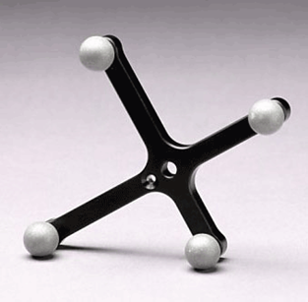
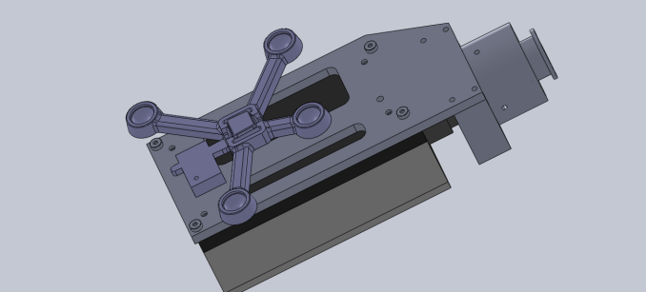

Tracked Orientation
M2
M1
Conoprobe Laser orientation+distance
Neutral (Rom file)

Slide 3
Tracked Orientation
M2
Conoprobe Laser orientation+distance
Unknown: M2 transform between laser origin+orientation
to tracked body origin+orientation

Slide 4
2 Points define a line i.e. orientation of laser emitter
Distance from cono gives emitter origin translation

Slide 5
In Practice

Slide 6
